Slide 1


Ad Hoc Request Analysis using SQL & Power BI
For ATLIQ HARDWARE
Prepared By: Pratik Shukla

Slide 2
Problem Statement
• AtliQ Hardware is a leading computer hardware producer in India and other countries.
• Management lacks insights for quick, data-informed decisions.
• Aim to expand the data analytics team with junior data analysts.
• Conducted a SQL challenge to facilitate data-driven decisions.

Slide 3
Query Analysis
We conducted several SQL queries to gather insights about AtliQ Hardware's business operations.

Slide 4
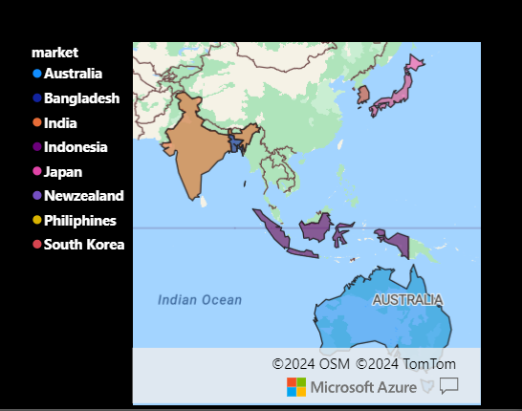
Query 1: Market Analysis
• Problem Statement: Identify the markets where 'Atliq Exclusive' operates in the APAC region.
• SQL Query:
SELECT DISTINCT market
FROM dim_customer
WHERE region = 'APAC' AND customer = 'Atliq Exclusive';
• Explanation: This query lists all the unique markets where the customer 'Atliq Exclusive' is active within the APAC region.

Slide 5
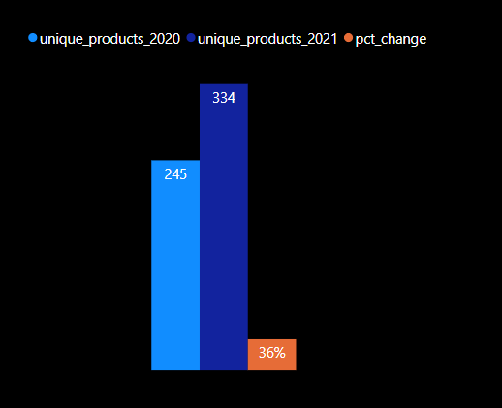
Query 2: Unique Product Increase Percentage
• Problem Statement: What is the percentage of unique product increase in 2021 vs. 2020?
• SQL Query:
WITH unique_products_2020 AS (
SELECT COUNT(DISTINCT p.product_code) AS Total_unique_products_2020
FROM dim_product p
JOIN fact_gross_price gp ON p.product_code = gp.product_code
WHERE gp.fiscal_year = 2020),
unique_products_2021 AS (
SELECT COUNT(DISTINCT p.product_code) AS Total_unique_products_2021
FROM dim_product p
JOIN fact_gross_price gp ON p.product_code = gp.product_code
WHERE gp.fiscal_year = 2021)
SELECT ROUND((u21.Total_unique_products_2021 - u20.Total_unique_products_2020) / u20.Total_unique_products_2020 * 100, 2) AS pct_change
FROM unique_products_2021 u21, unique_products_2020 u20;
• Explanation: This query calculates the percentage increase in unique products from 2020 to 2021.

Slide 6
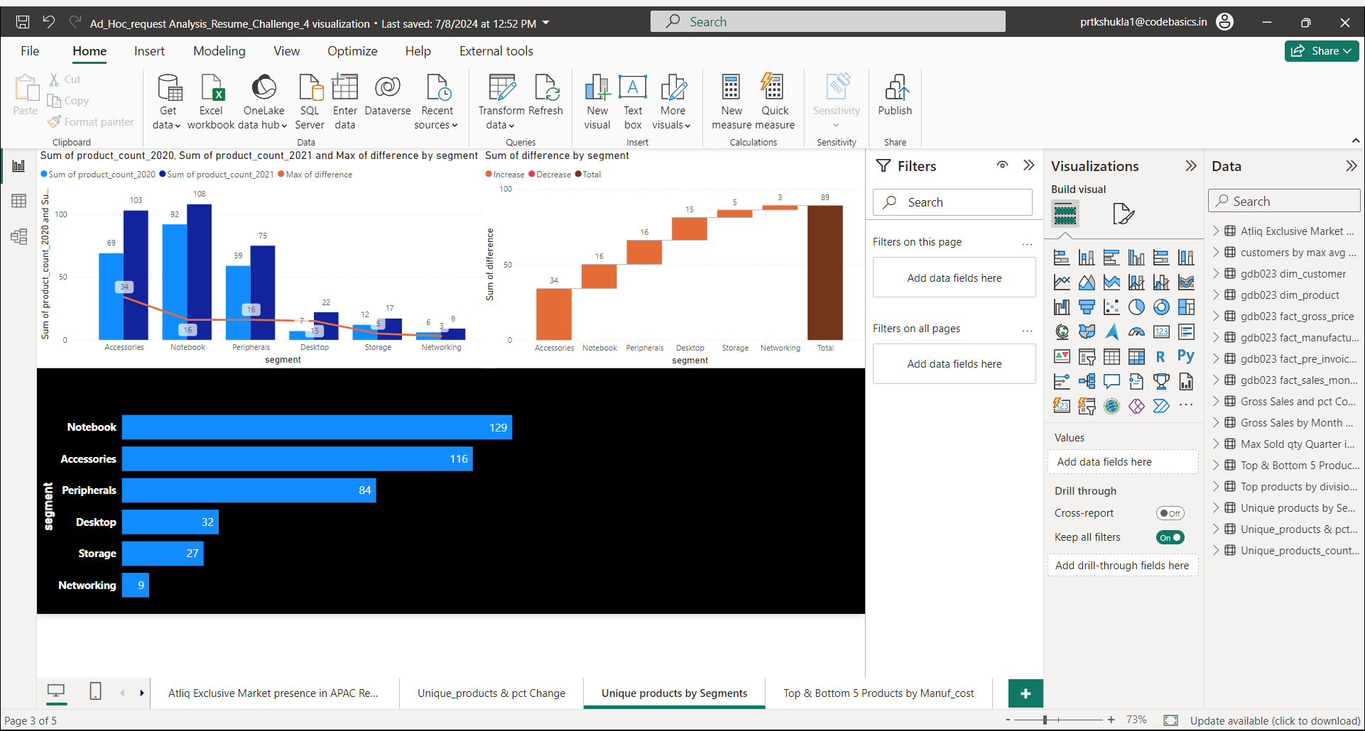
Query 3: Unique Products Count by Segment
• Problem Statement: Provide a report with all the unique product counts for each segment in descending
• SQL Query:
select
segment, Count(distinct(product_code)) as product_count
from dim_product
group by segment
order by product_count desc;
• Explanation: This query lists all the unique Products Count by each segment and sort them in descending order of Products count

Slide 7
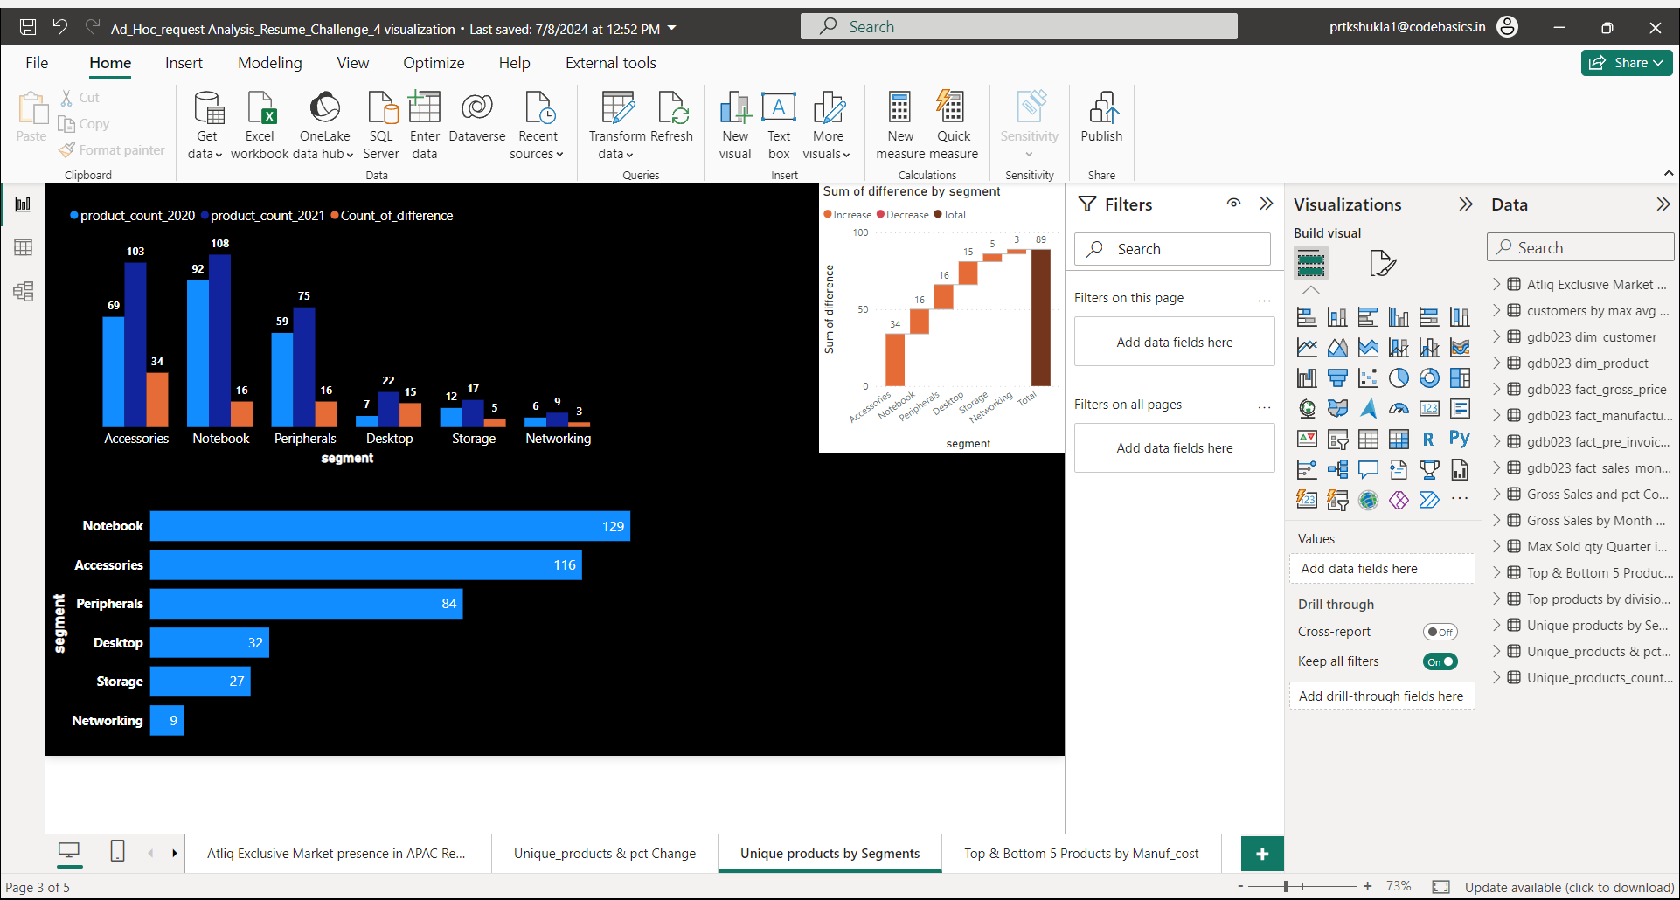
Query 4 : Unique Product Increase in 2021 Vs 2020 by Segment
Problem Statement : Which segment had the most increase in unique products in 2021 vs 2020?
• SQL Query:
WITH unique_product_2020 AS ( SELECT
p.segment, Count(Distinct p.product_code) AS product_count_2020
From dim_product p
Join fact_gross_price gp On p.product_code = gp.product_code
Where gp.fiscal_year = 2020 Group by p.segment),
unique_product_2021 AS ( SELECT
p.segment Count(Distinct p.product_code) AS product_count_2021 FROM dim_product p
Join fact_gross_price gp On p.product_code = gp.product_code
Where gp.fiscal_year = 2021 Group by p.segment)
SELECT
u21.segment , u20.product_count_2020 , u21.product_count_2021, (u21.product_count_2021 - u20.product_count_2020) AS difference From unique_product_2020 u20
Join unique_product_2021 u21 On u20.segment = u21.segment
Order by difference DESC;
• Explanation: This query lists all the Unique Products in 2021 compared to 2020 & the Difference between them by segments

Slide 8
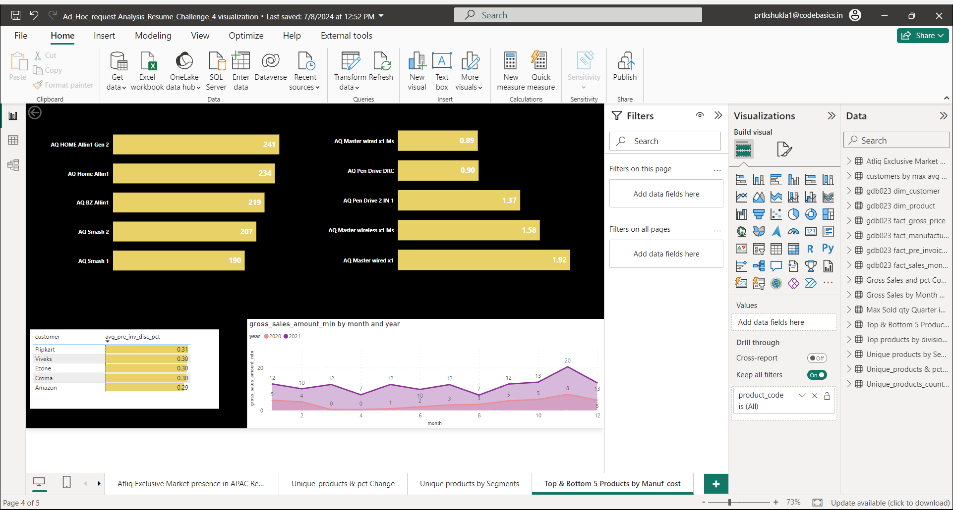
Query 5 : Products with High-Low Manufacturing Costs
Problem Statement : Get the products that have the highest and lowest manufacturing costs.
• SQL Query:
(SELECT
sub.product_code, sub.product, sub.manufacturing_cost
From ( SELECT p.product_code, p.product, mc.manufacturing_cost,
ROW_NUMBER() OVER (PARTITION BY p.product
ORDER BY mc.manufacturing_cost DESC) as rnk
From dim_product p Join fact_manufacturing_cost mc
On p.product_code = mc.product_code) sub Where sub.rnk = 1
Order by sub.manufacturing_cost DESC LIMIT 5) -- # Get Products with Highest manufacturing costs
UNION ALL
(SELECT sub.product_code, sub.product, sub.manufacturing_cost
FROM ( SELECT p.product_code, p.product, mc.manufacturing_cost,
ROW_NUMBER() OVER (PARTITION BY p.product
ORDER BY mc.manufacturing_cost ASC) as rnk
From dim_product p Join fact_manufacturing_cost mc
On p.product_code = mc.product_code) sub
Where sub.rnk = 1 Order by sub.manufacturing_cost ASC LIMIT 5); --# Get Products with lowest manufacturing costs

Slide 9
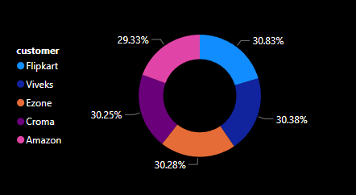
Query 6 : Top 5 Customers by High Avg Price Discount in Indian Market
• Problem Statement: Generate a report which contains the top 5 customers who received an average high pre_invoice_discount_pct for the fiscal year 2021 and in the -- Indian market.
• SQL Query:
with cte_avg_disc as (
SELECT c.customer_code,c.customer,
Round(Avg(pid.pre_invoice_discount_pct),2) as avg_pre_inv_disc_pct,
dense_rank() over(order by AVG(pid.pre_invoice_discount_pct) desc) as drank
From dim_customer c
Join fact_pre_invoice_deductions pid
On c.customer_code = pid.customer_code
where pid.fiscal_year = 2021 and c.market = "India“
group by c.customer_code,c.customer)
Select customer_code,customer,avg_pre_inv_disc_pct
from cte_avg_disc where drank <=5;
• Explanation: This query lists Top 5 Customers who received an Avg High Pre Invoive Discount % in FY 2021 & in the Indian market

Slide 10
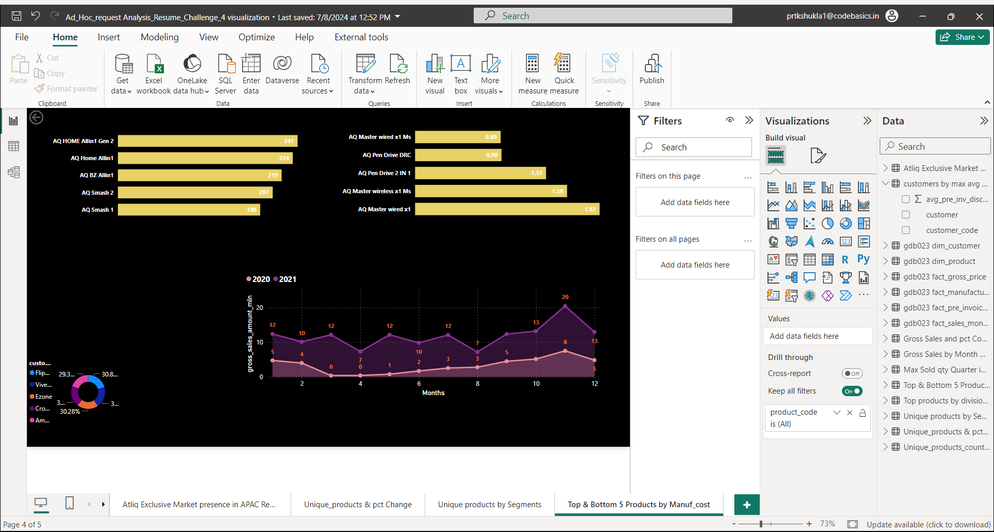
Query 7 : Trend of Gross Sales for AtliQ Exclusive
• Problem Statement: Generate the complete report of the Gross sales amount for the customer “Atliq Exclusive” for each month. Which will helps to get an idea of low and -- high-performing months and take strategic decisions.
• SQL Query:
SELECT
month(sm.date) as month,sm.fiscal_year as year, Round(sum(sm.sold_quantity * gp.gross_price)/1000000,2) as gross_sales_amount_mln
From fact_sales_monthly sm
Join dim_customer c
On c.customer_code = sm.customer_code
Join fact_gross_price gp
On sm.product_code = gp.product_code and
sm.fiscal_year = gp.fiscal_year
Where c.customer = 'Atliq Exclusive’
Group by month,year
Order by year;
• Explanation: This query Results in a Trend of Gross Sales Amount for AtliQ Exclusive over a period. We can see a drop at every 4 months in 2021 and have highs on every 3rd month

Slide 11
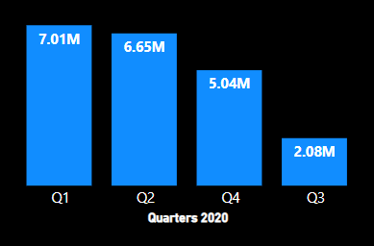
Query 8: Quarterly Analysis
• Problem Statement: In which quarter of 2020, got the maximum total_sold_quantity?
• SQL Query:
SELECT
CASE
WHEN MONTH(date) IN (9, 10, 11) THEN 'Q1'
WHEN MONTH(date) IN (12, 1, 2) THEN 'Q2'
WHEN MONTH(date) IN (3, 4, 5) THEN 'Q3'
WHEN MONTH(date) IN (6, 7, 8) THEN 'Q4'
END AS Quarter,
Sum (sold_quantity) AS total_sold_quantity
From fact_sales_monthly
Where fiscal_year = 2020
Group By Quarter
Order By total_sold_quantity DESC
LIMIT 1;
Explanation : This Query results in Total Qty Sold by Quarters in a year. From the Bar chart we can clearly understand that Q1 brings the maximum sold Qty for Atliq hardwares

Slide 12
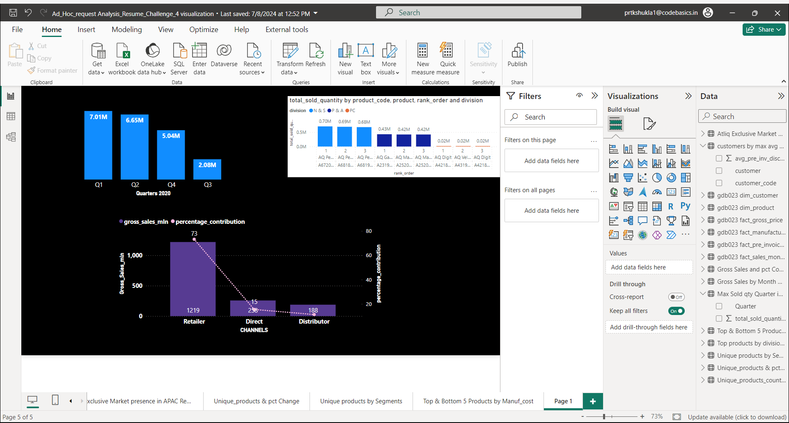
Query 9: Channel Analysis
• Problem Statement: Which channel helped to bring more gross sales in the fiscal year 2021 and the percentage of contribution?
• SQL Query:
with channel_sales as (
SELECT
c.channel, sum(sm.sold_quantity * gp.gross_price)/1000000 as gross_sales_mln
From fact_sales_monthly sm
Join dim_customer c
On c.customer_code = sm.customer_code
Join fact_gross_price gp
On gp.product_code = sm.product_code and gp.fiscal_year = sm.fiscal_year
Where sm.fiscal_year = 2021
Group By c.channel),
total_sales as (
SELECT sum(gross_sales_mln) as total_gross_sales
from channel_sales)
select channel, Round (gross_sales_mln,2) as gross_sales_mln,
Round((gross_sales_mln/total_gross_sales)*100,2) as percentage
From channel_sales, total_sales
Order by gross_sales_mln desc;
Explanation: This Query results in Understanding the Gross Sales and Contribution % across the channels. we can see that “Retailer” is the Highest contributor for AtliQ Hardwares

Slide 13
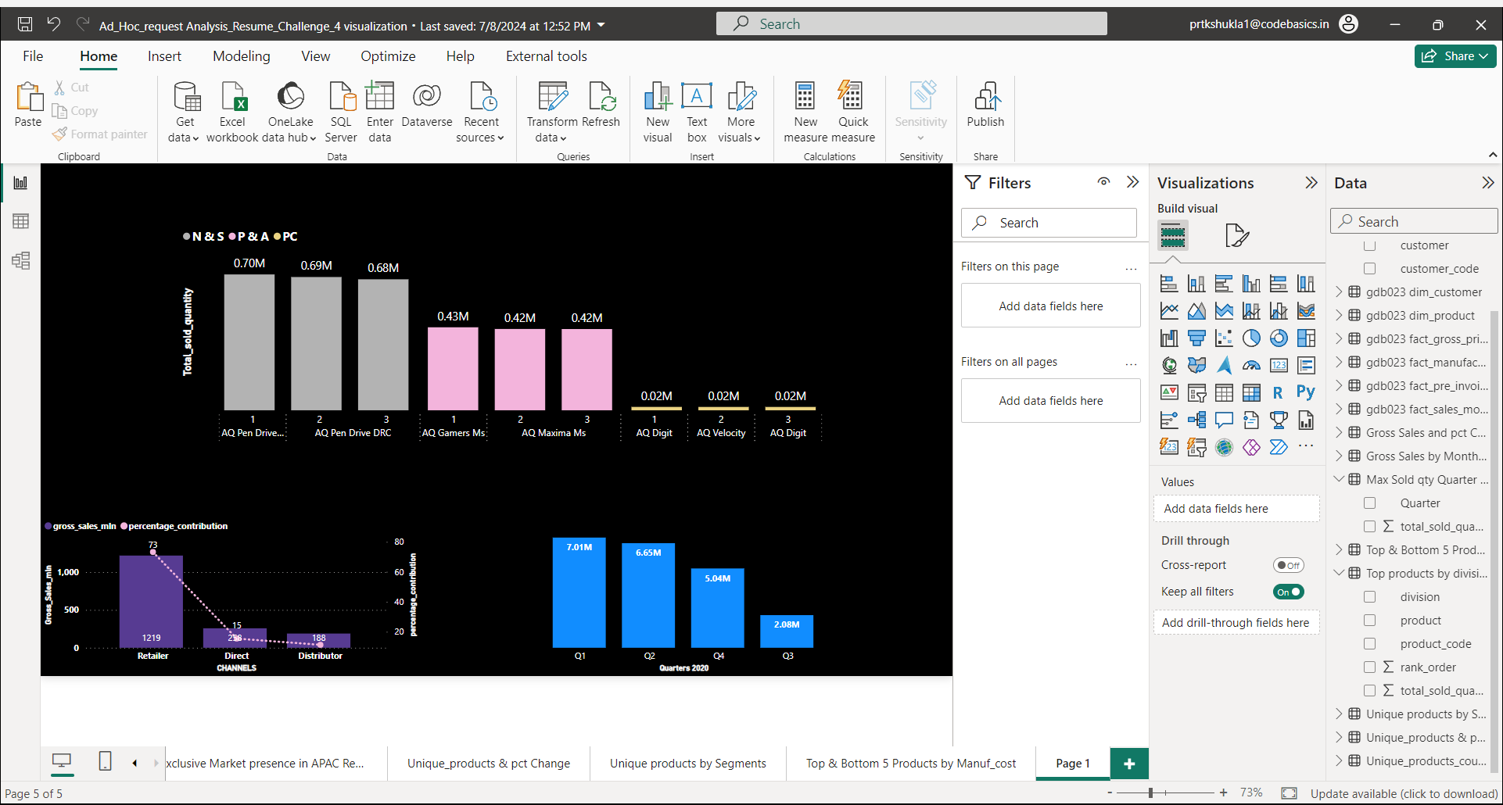
Query 10: Analysis by Division
• Problem Statement: Get the Top 3 products in each division that have a high total_sold_quantity in the fiscal_year 2021?
• SQL Query:
with cte as (
SELECT
p.division,p.product_code,p.product, SUM(sm.sold_quantity) as total_sold_quantity,
RANK() over(partition by p.division order by SUM(sm.sold_quantity) desc) as rank_order
From dim_product p
Join fact_sales_monthly sm
On sm.product_code = p.product_code
Where sm.fiscal_year = 2021
Group By p.division, p.product_code, p.product)
SELECT
division, product_code, product, total_sold_quantity,
rank_order From cte
Where rank_order <=3
Order By total_sold_quantity desc;
Explanation: This query results in Top 3 products from each division having High Sold qty in FY 2021. We can observe that N& S division tops the list with the Product pen drive

Slide 14
THANK YOU!

